Slide 1

Steel Data
Challenge 1 Car Sales

Slide 2
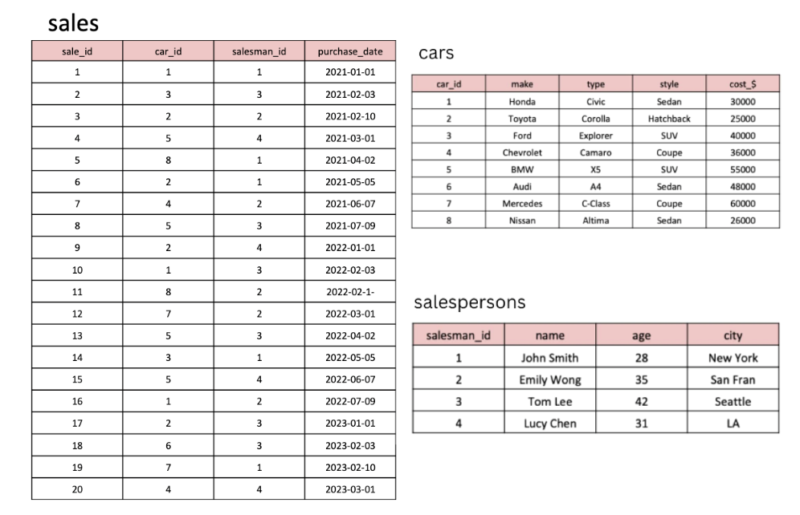
Steve runs a top-end car showroom but his data analyst has just quit and left him without his crucial insights. Need to analyse the following data with 10 questions to provide him all the answers he requires.
Tables

Slide 3
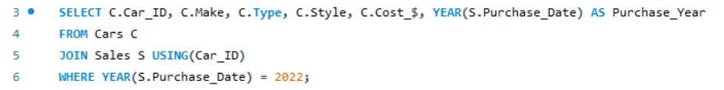
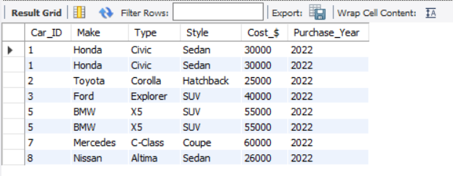
Question 1) What are the details of all cars purchased in the year 2022?
INPUT
OUTPUT

Slide 4
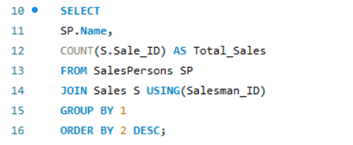
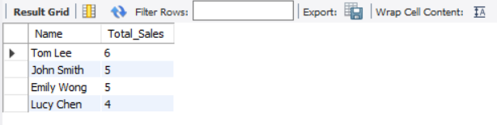
Question 2) What is the total number of cars sold by each salesperson?
INPUT
OUTPUT

Slide 5
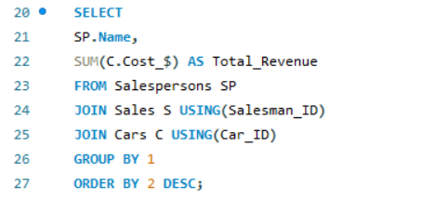
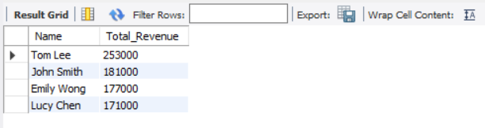
Question 3) What is the total revenue generated by each salesperson?
INPUT
OUTPUT

Slide 6
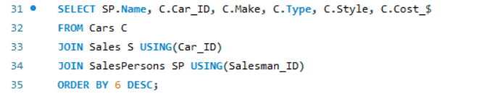
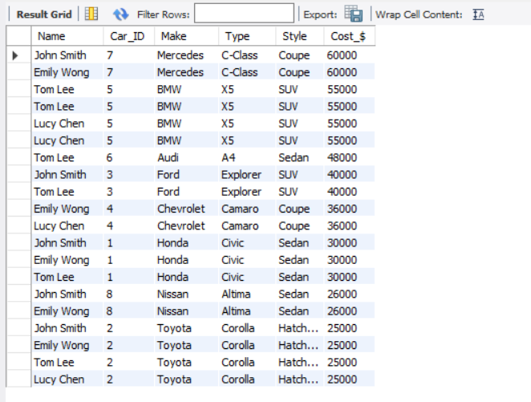
Question 4) What are the details of the cars sold by each salesperson?
INPUT
OUTPUT

Slide 7
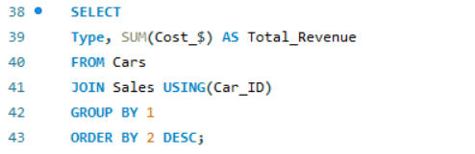
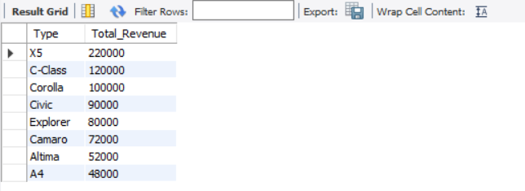
Question 5) What is the total revenue generated by each car type?
INPUT
OUTPUT

Slide 8
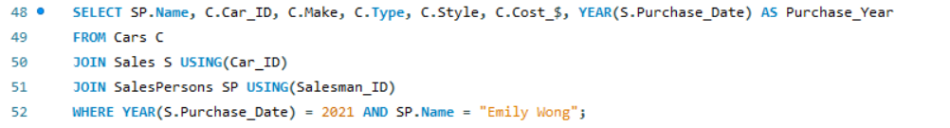
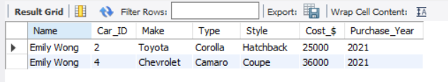
Question 6) What are the details of the cars sold in the year 2021 by salesperson 'Emily Wong'?
INPUT
OUTPUT

Slide 9
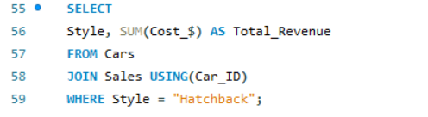
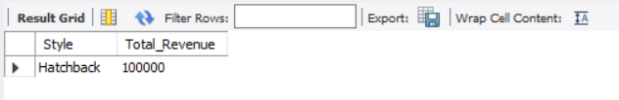
Question 7) What is the total revenue generated by the sales of hatchback cars?
INPUT
OUTPUT

Slide 10
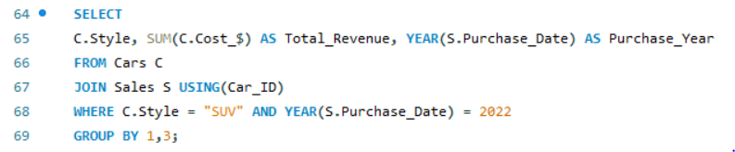

Question 8) What is the total revenue generated by the sales of SUV cars in the year 2022?
INPUT
OUTPUT

Slide 11
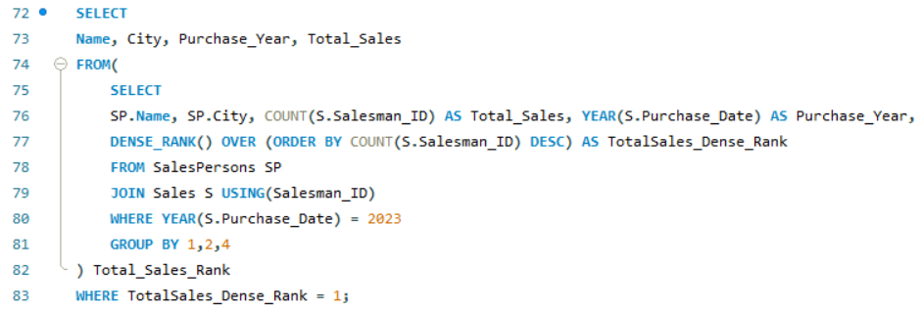

Question 9) What is the name and city of the salesperson who sold the most number of cars in the year 2023?
INPUT
OUTPUT

Slide 12
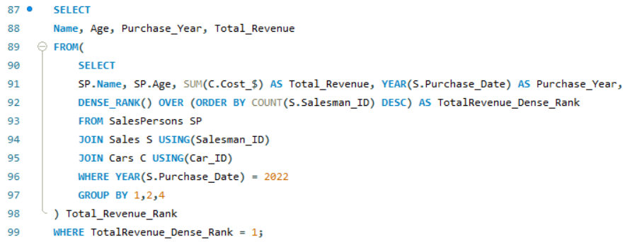

Question 10) What is the name and age of the salesperson who generated the highest revenue in the year 2022?
INPUT
OUTPUT

Slide 13


Thank You
By Sebnem Basaran
sebnembasaran@outlook.com
Portfolio:
https://www.novypro.com/profile_projects/sebnembasaran
Github:
https://github.com/sebnembasaran?tab=repositories

